Slide 1
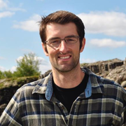
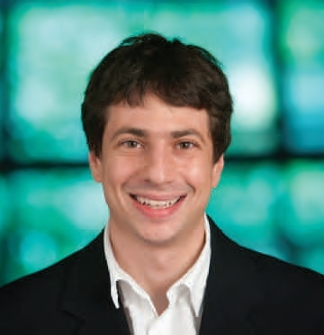
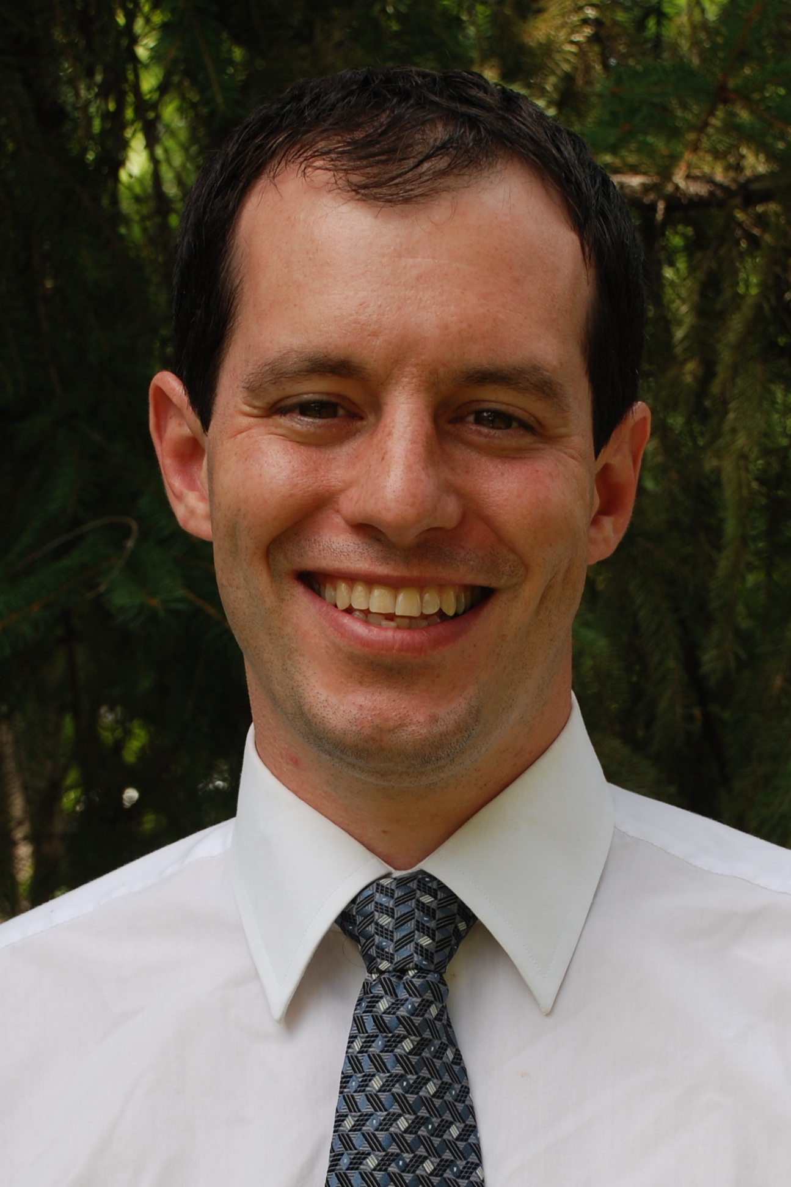
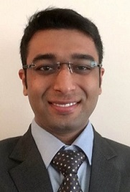


Max-Information,
Differential Privacy, and
Post-Selection Hypothesis Testing
Ryan Rogers, Aaron Roth, Adam Smith, and Om Thakkar
Supported by grants from the Sloan Foundation and NSF:
CNS-1253345, CNS-1513694, IIS-1447700.

Slide 2






Adaptive Data Analysis
??
$$t$$
$$t(X)$$
$$X\sim P^{n}$$
Analysis $t$
Notes:
Being in an adaptive data analysis workshop…

Slide 3



Adaptive Data Analysis
??
$$t$$
$$t(X)$$
$$t′$$
$$t′(X)$$
$$X\sim P^{n}$$
$$t^{′}=f\left(t\left(X\right)\right)$$
How can we provide statistically valid answers to
adaptively chosen analyses?
Notes:
We then model the analyst as adaptively selecting different tests.
We want to address this question when we deal with adaptive data analyses.

Slide 4




Adaptive Data Analysis
??
$$t$$
$$t(X)$$
$$a$$
$$t′$$
$$t′(X)$$
$$X\sim P^{n}$$
$$t^{′}=f\left(a\right)$$
Answer: Limit the info learned about the dataset with each analysis [Dwork,Feldman,Hardt,Pitassi,Reingold,Roth’15].
Notes:
One answer to this was initiated by Dwork et al. which limits the information learned about the dataset from the test t’
If we limit the amount of information that is learned about the data with each analysis, then the choice of test will be close to independent of the data.
When we analyze the information of the dataset from the test t’, we can group together the function f and the output a as a single test selection procedure A(X), which we then analyze the information that it reveals.

Slide 5



Adaptive Data Analysis
??
$$t$$
$$A(X)$$
$$t′$$
$$t^{′}(X)$$
$$X\sim P^{n}$$
$$t^{′}=A\left(X\right)$$
Answer: Limit the info learned about the dataset [Dwork,Feldman,Hardt,Pitassi,Reingold,Roth’15].
Notes:
We then focus on what types of test selection procedures prevent information leakage about the dataset.

Slide 6
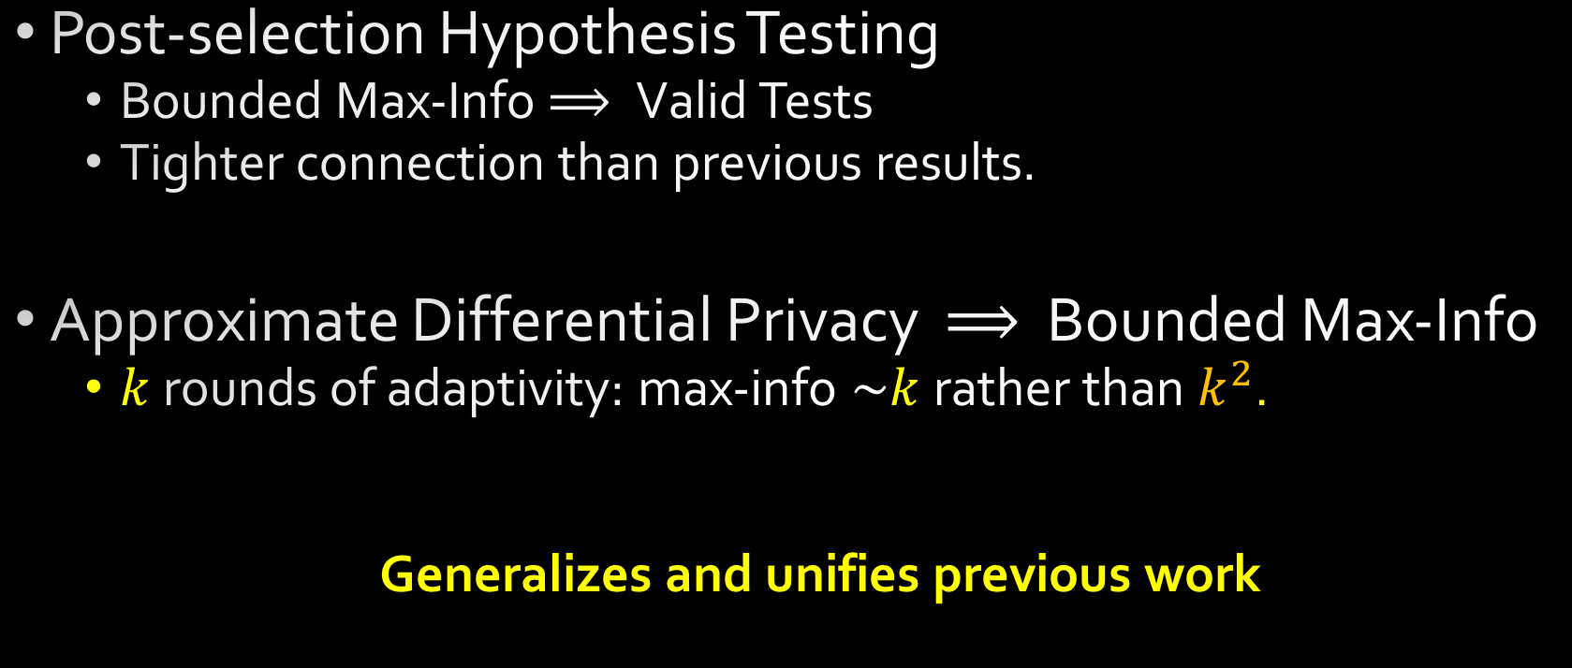
Contributions
Post-selection Hypothesis Testing
Bounded Max-Info$⟹$Valid Tests
Tighter connection than previous results.
Approximate Differential Privacy $⟹$ Bounded Max-Info
$k$ rounds of adaptivity: max-info $\sim k$ rather than $k^{2}$.
Generalizes and unifies previous work
Notes:
With this model of adaptive data analysis in the top right.
We continue this line of work by considering the problem of post-selection hypothesis testing - selecting hypothesis tests as a function of the data.
We show that bounding max information of the test selection procedure can help us bound the probability of false discovery, even when the tests are selected adaptively, which leads to valid tests.
By bounding max-info we get a tighter connection than previous results.
Our more technical results show that test selection procedures that are differentially private, specifically approximate differentially private, have bounded information. We can then obtain a quadratic improvement in the dependence on the number of rounds of adaptivity in our max info bounds.
We then point out that these result generalize and unifies previous work in this area.

Slide 7
Related Work
Lots of work in statistics community on post-selection inference [Freedman’83],[Leeb,Potscher’06],[Berk,Brown,Buja,Zhang,Zhao’13], ...
Specific to type of analyses performed
[DFHPRR](STOC’15,NIPS’15,Science’15)
Initial connections between information, privacy and adaptive analysis
Accuracy for specific queries
[DFHPRR] (STOC’15,Science’15)
[Bassily,Nissim,Smith,Steinke,Stemmer,Ullman’16]
[Cummings,Ligett,Nissim,Roth,Wu’16]
[Russo,Zou’16]
[Wang,Lei,Fienberg’16]
Impossibility results
[Hardt,Ullman’14], [Steinke,Ullman’15]
Notes:
Statistics community – tailored toward specific sequences of analyses: LASSO model selection followed by least squares regress.
Freedman – Freedman Paradox – one of the earliest works that talks about post selective inference
BBBZZ – Berk et al. – variable selection followed by inference on the selected model
Recently in the computer science community, Dwork et al. study this problem in greater generality with the model presented.
Then subsequent follow up work on this work dealing with specific types of queries. Also there have been some impossibility results for adaptively estimating means.
RZ’16 – Bias – subgaussian queries
WLF’16 – Squared error – jointly gaussian queries

Slide 8
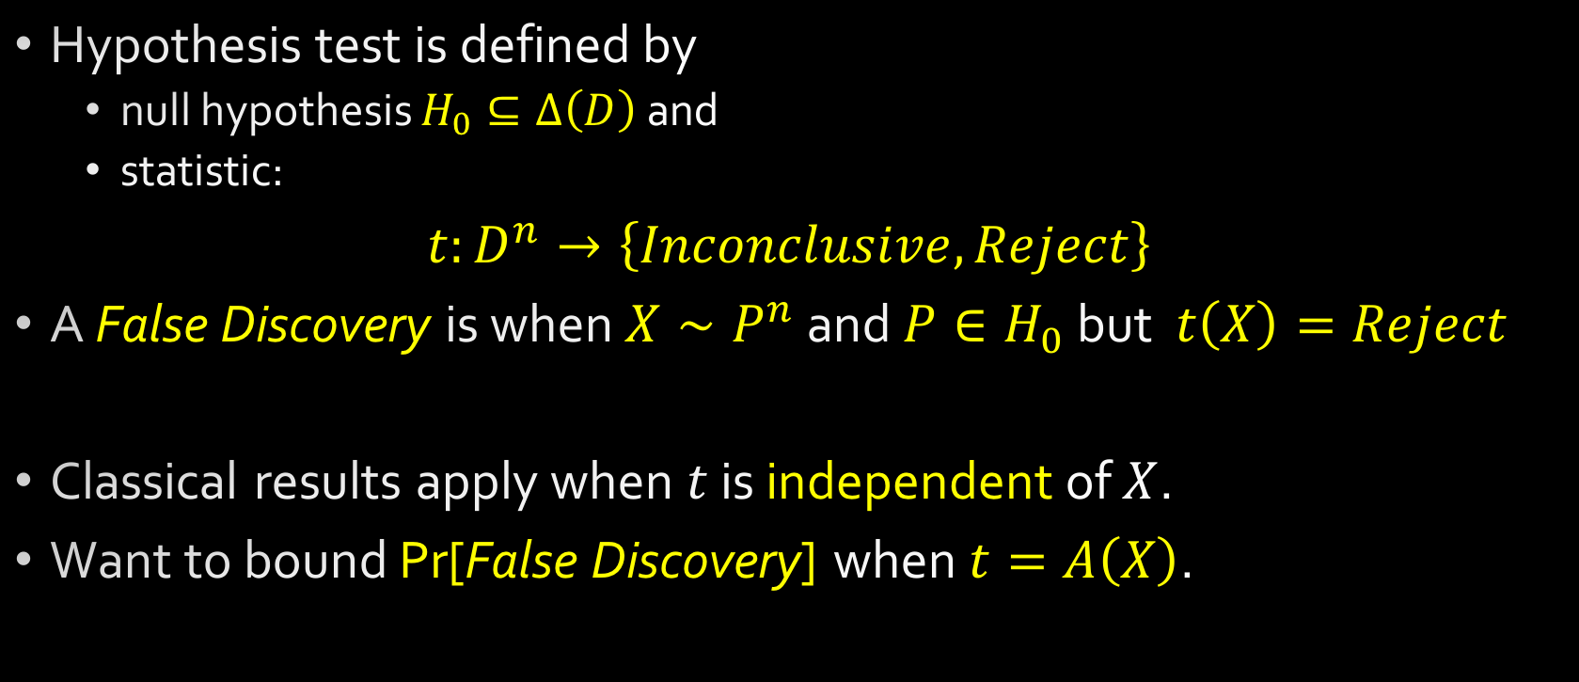
Hypothesis Testing
Hypothesis test is defined by
null hypothesis $H_{0}⊆Δ\left(D\right)$and
statistic:
$t:D^{n}→\left\{Inconclusive,Reject\right\}$
A False Discovery is when $X∼P^{n}$ and $P∈H_{0}$ but $t\left(X\right)=Reject$
Classical results apply when$t$ is independent of $X$.
Want to bound Pr[False Discovery] when $t=A\left(X\right)$.
Notes:
Want to go over an example of some adaptive data analyses you may want to conduct.
Null hypothesis is a subset of data distributions.
The goal is to reject $H_{0}$ if the data $X$ is not likely to have been generated from that model.
For adaptive settings, we would like to know how to still ensure prob of false discovery at most alpha.

Slide 9
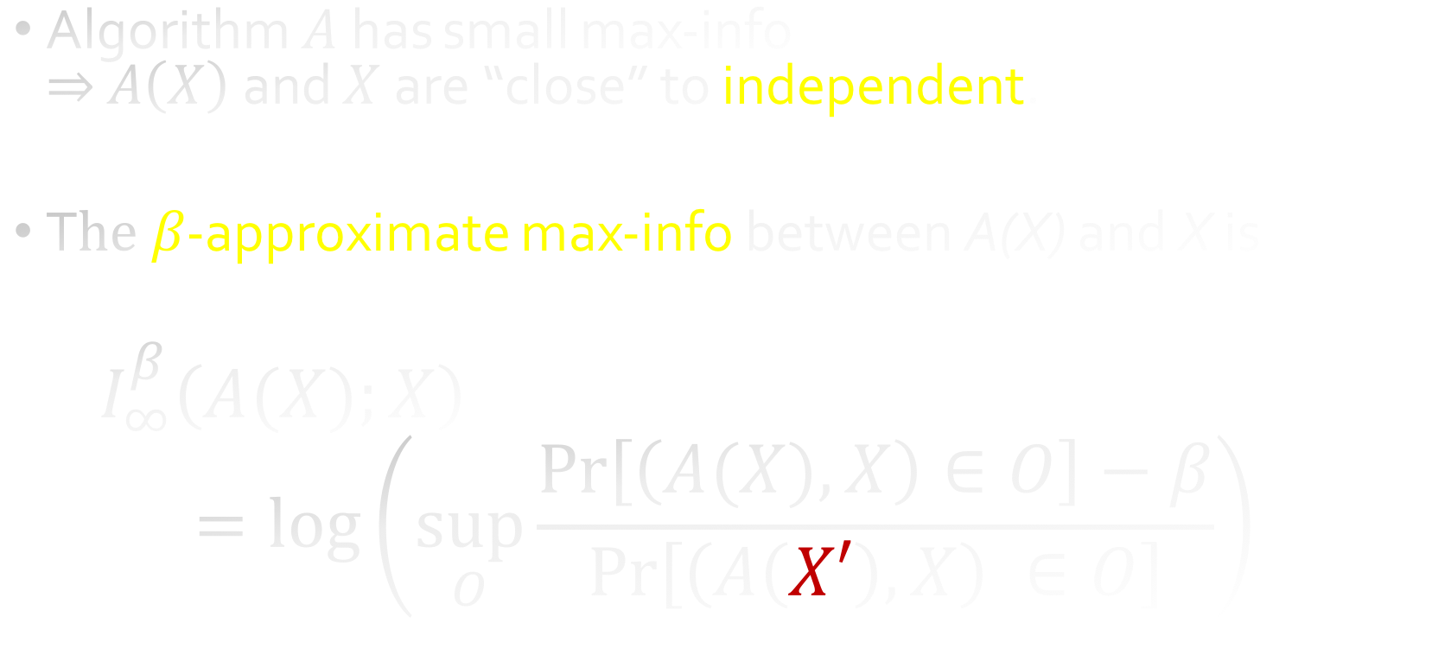
Max-Information [DFHPRR’15]
Algorithm $A$has small max-info $⇒$ $A\left(X\right)$ and $X$are “close” to independent.
T$he β$-approximate max-info between A(X) and X is
$I_{∞}^{β}\left(A(X);X\right)$
$$=log\left(\sup_{O}\frac{\operatorname{Pr}\left[\left(A(X),X\right)∈O\right]−β}{\operatorname{Pr}\left[\left(A\left(X′\right),X\right) ∈O\right]}\right)$$
Real World
Ideal World
Notes:
We then talk about the type of procedures we allow the analyst to use.
We restrict the set of test selection procedures to be those with bounded max information.
Introduced by Dwork et al., max-info allows the analyst to treat the test selection procedure and the data as being independent, up to a factor.
Let's unpack this definition.
Ideal world – Tons of research from statistics on this quantity, where X and X’ are independent.
Mutual Information is then the expected value of this quantity. Max info is worst case notion of mutual info.

Slide 10
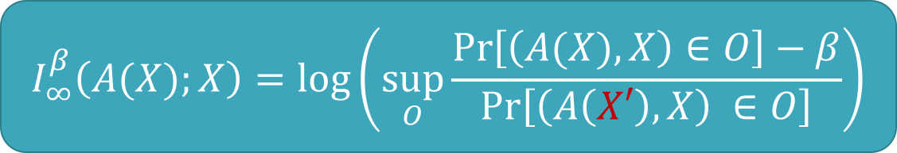
Max-Information of Algorithms [DFHPRR’15]
$$I_{∞}^{β}\left(A(X);X\right)=log\left(\sup_{O}\frac{\operatorname{Pr}\left[\left(A(X),X\right)∈O\right]−β}{\operatorname{Pr}\left[\left(A\left(X′\right),X\right) ∈O\right]}\right)$$
An algorithm $A$has $β$-approximate max-info for data sets of size $n$ if
$$I_{∞}^{β}\left(A;n\right)=\sup_{𝒮:X∼𝒮}\left\{I_{∞}^{β}\left(A\left(X\right);X\right)\right\}$$
$$I_{∞,Π}^{β}\left(A;n\right)=\sup_{P:X∼P^{n}}\left\{I_{∞}^{β}\left(A\left(X\right);X\right)\right\}$$
any data distribution
restrict to product distribution
Notes:
Then the max-info over a test selection procedure with data of size n is the largest the max-info can be between the selection procedure and the data over all possible data distributions.
Not knowing the data distribution, we just take the sup.
Important to distinguish between arbitrary data distributions and product distributions.

Slide 11
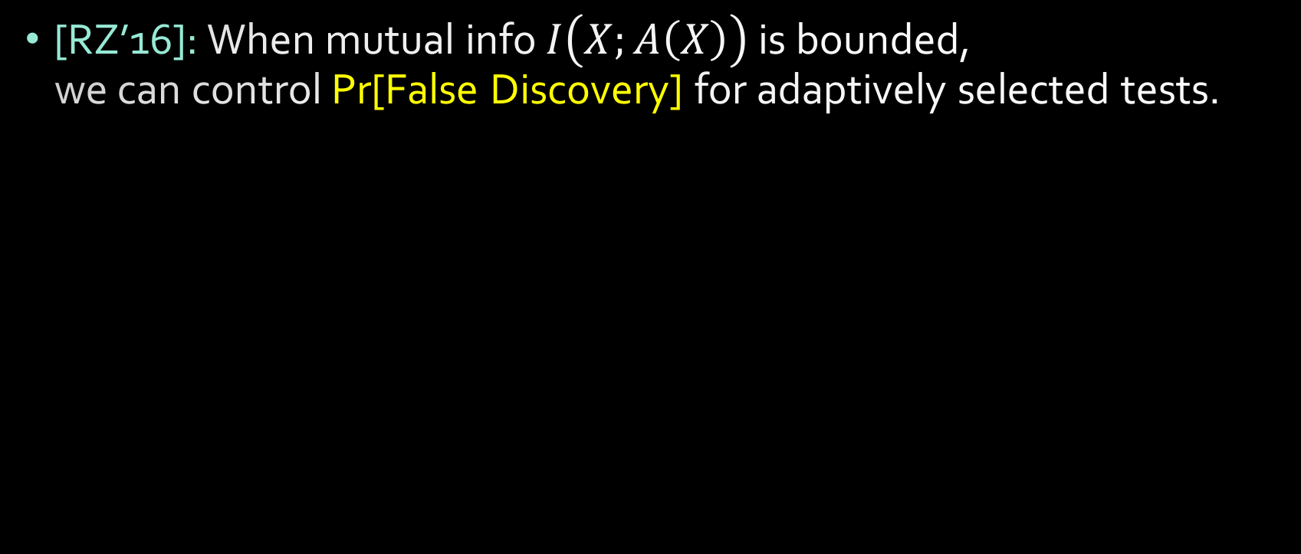
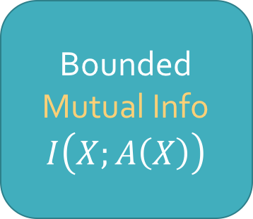
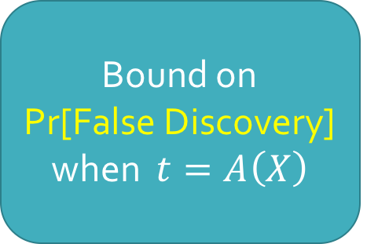

Post-selection Hypothesis Testing
[RZ’16]: When mutual info $I\left(X;A\left(X\right)\right)$ is bounded, we can control Pr[False Discovery] for adaptively selected tests.
$$⟹$$
Bounded Mutual Info
$$I\left(X;A\left(X\right)\right)$$
Bound on
Pr[False Discovery] when $t=A\left(X\right)$
Notes:
Even when we use the data to determine a hypothesis test, we still want to be able to control the probability of false discovery.
We want to know what procedures allow us to bound the probability of false discovery in the adaptive setting.
Russo and Zou do show

Slide 12
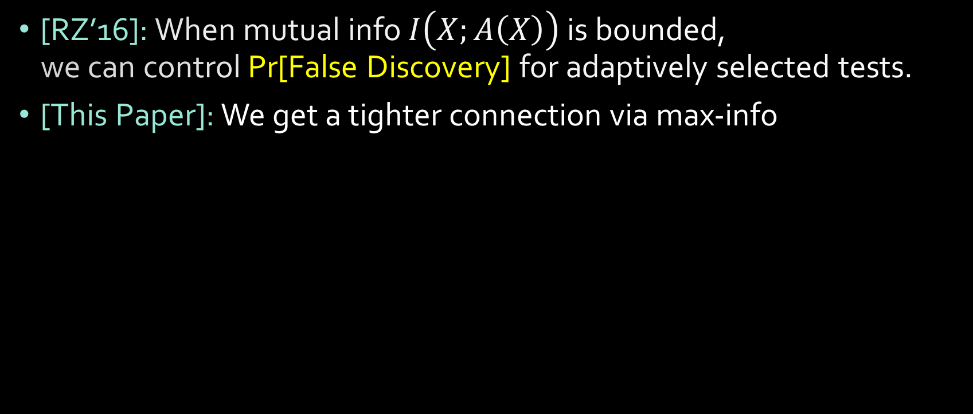
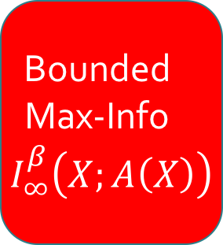


Post-selection Hypothesis Testing
[RZ’16]: When mutual info $I\left(X;A\left(X\right)\right)$ is bounded, we can control Pr[False Discovery] for adaptively selected tests.
[This Paper]: We get a tighter connection via max-info
Bounded Mutual Info
$$I\left(X;A\left(X\right)\right)$$
Bounded
Max-Info $I_{∞}^{β}\left(X;A\left(X\right)\right)$
Bound on
Pr[False Discovery] when $t=A\left(X\right)$
$$⟹$$
$$⟹$$
Notes:
Mutual information deals with average case and max info is worst case.
We improve on this result by going through max-info and then showing that mutual info implies max info.

Slide 13

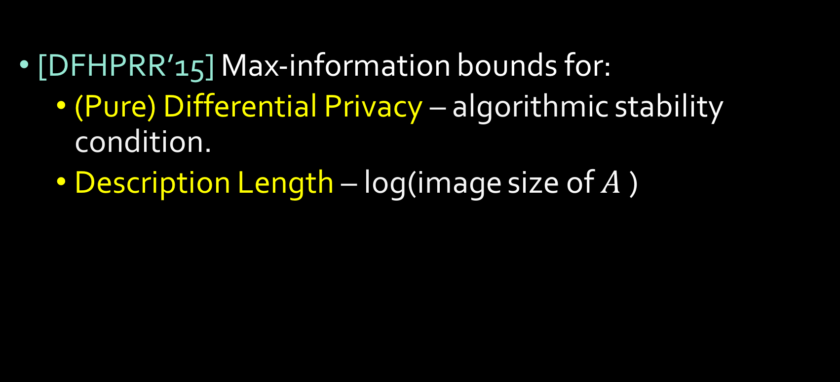
What procedures $A$ have bounded max-info?
[DFHPRR’15] Max-information bounds for:
(Pure) Differential Privacy – algorithmic stability condition.
Description Length – log(image size of $A$)
Notes:
Bounded description length – those whose output description is small
Separately, these two procedures were shown to give adaptive generalization guarantees.
Max-info can be thought of as a unifying measure that controls the generalization guarantees of different adaptive data analyses.
More general notion of differential privacy in which we can get much more accurate solutions in which their results do not apply
_____________________________________
Nice composition rules: if $I_{∞}^{β_{1}}\left(A_{1},n\right)≤m_{1}$ and $I_{∞}^{β_{2}}\left(A_{2},n\right)≤m_{2}$ then
$$I_{∞}^{β_{1}+β_{2}}\left(A_{1}∘A_{2},n\right)≤m_{1}+m_{2}$$
Further has useful composition properties, so that we can string together different analyses with bounded max-info and the result will still have good generalization properties.

Slide 14
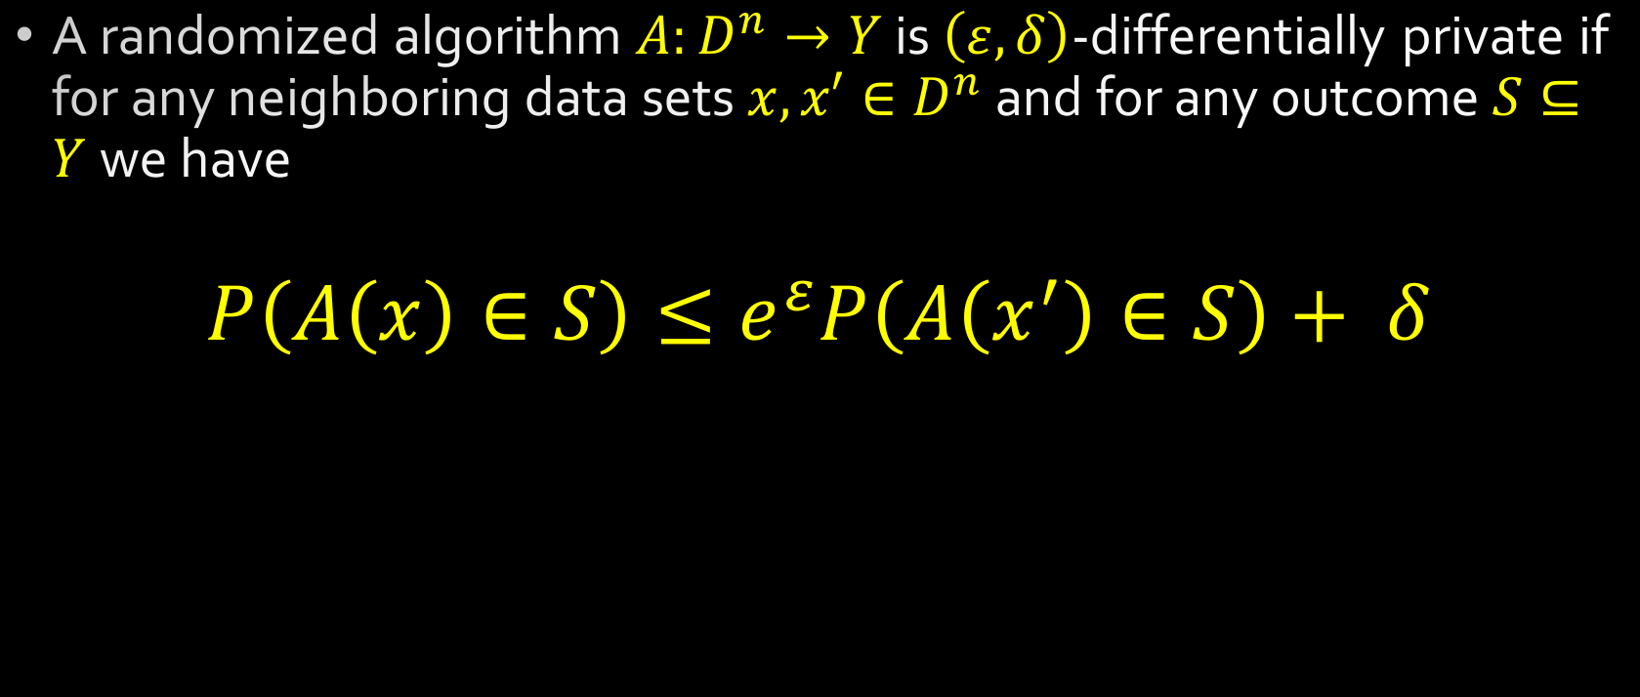
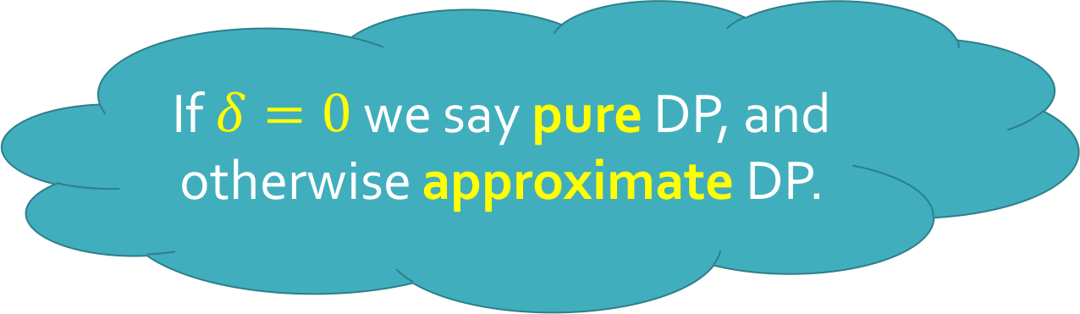
Differential Privacy [Dwork,McSherry,Nissim,Smith’06]
A randomized algorithm $A:D^{n}→Y$ is $\left(ε,δ\right)$-differentially private if for any neighboring data sets $x,x′∈D^{n}$ and for any outcome $S⊆Y$ we have
$$P\left(A\left(x\right)∈S\right)≤e^{ε}P\left(A\left(x^{′}\right)∈S\right)+ δ$$
If $δ=0$ we say pure DP, and otherwise approximate DP.
Notes:
In order to present our technical contributions, we need to go a little further in detail with differential privacy.
An algorithm…

Slide 15
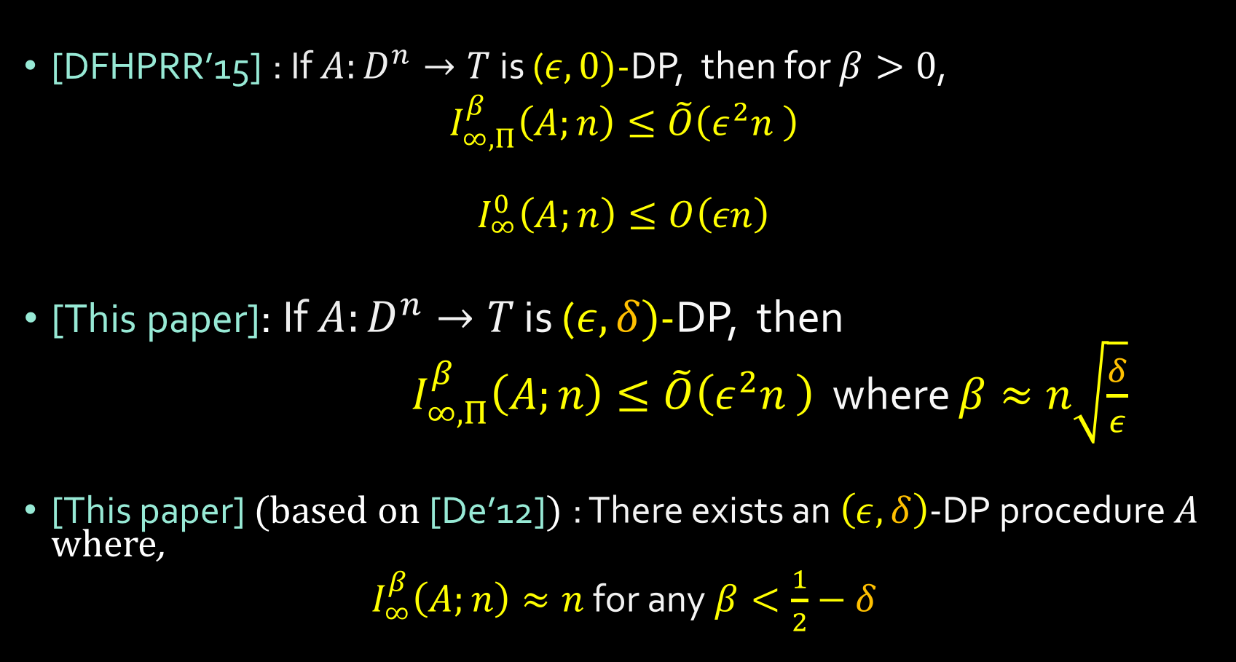
Technical Contributions
[DFHPRR’15] : If $A:D^{n}→T$ is ($ε,0)$-DP, then for $β>0$,
$I_{∞,Π}^{β}\left(A;n\right)≤\tilde{O}\left(ε^{2}n \right)$
$$I_{∞}^{0}\left(A;n\right)≤O\left(εn\right)$$
[This paper]: If $A:D^{n}→T$ is ($ε,δ)$-DP, then
${ I}_{∞,Π}^{β}\left(A;n\right)≤\tilde{O}\left(ε^{2}n \right)$ where $β≈n\sqrt{\frac{δ}{ε}}$
[This paper] (based on [De’12]) : There exists an $\left(ε,δ\right)$-DP procedure $A$ where,
$I_{∞}^{β}\left(A;n\right)≈n$ for any $β<\frac{1}{2}−δ$
Notes:
Note the distinction between max info bounds for arbitrary data distributions and product data distributions.
We achieve a bound on max-info with product distributions for the much larger class of $(ε,δ)$-DP algorithms.

Slide 16
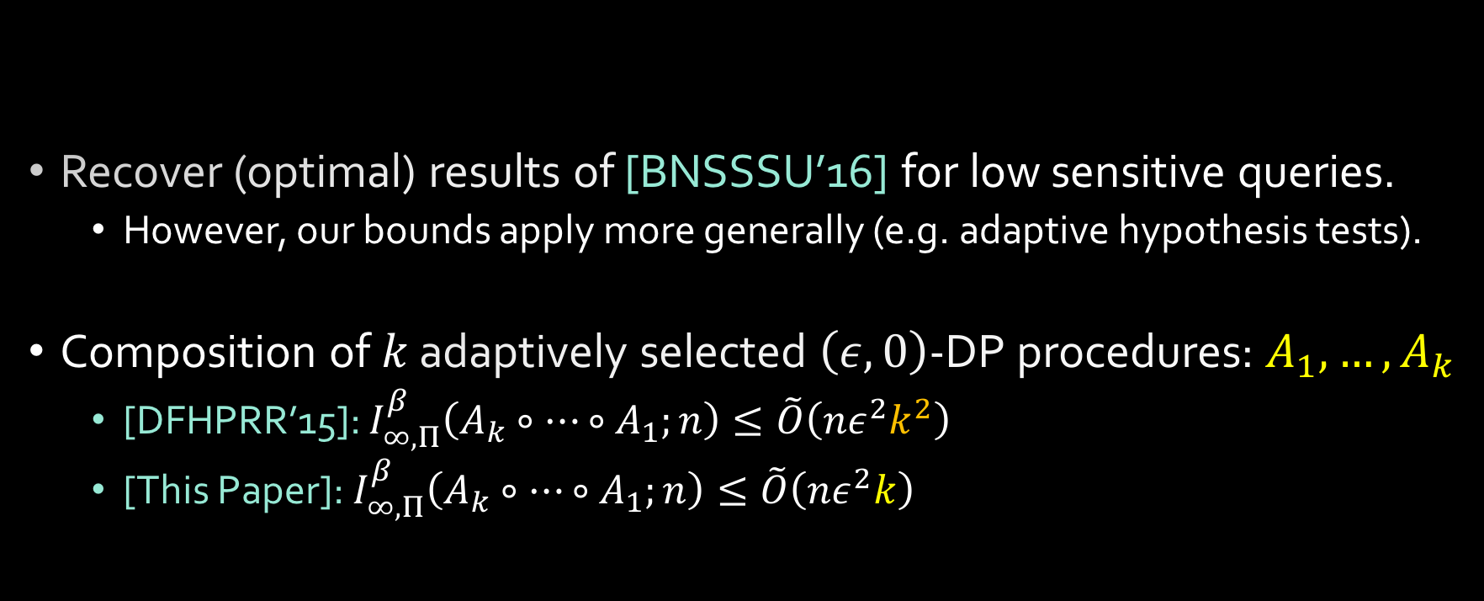

Consequences of Positive Result
Theorem: If $A:D^{n}→T$ is ($ε,δ)$-DP, then
$I_{∞,Π}^{β}\left(A;n\right)≤\tilde{O}\left(ε^{2}n \right)$ where $β≈n\sqrt{\frac{δ}{ε}}$
Recover (optimal) results of [BNSSSU’16] for low sensitive queries.
However, our bounds apply more generally (e.g. adaptive hypothesis tests).
Composition of $k$ adaptively selected $\left(ε,0\right)$-DP procedures: $A_{1}, …, A_{k}$
[DFHPRR’15]: $I_{∞,Π}^{β}\left(A_{k}∘⋯∘A_{1};n\right)≤\tilde{O}\left(nε^{2}k^{2}\right)$
[This Paper]: $I_{∞,Π}^{β}\left(A_{k}∘⋯∘A_{1};n\right)≤\tilde{O}\left(nε^{2}k\right)$
Via strong composition theorem from [Dwork,Rothblum,Vadhan’10]
Notes:
Applying our new results shows that we can get a quadratic improvement on the number of rounds of adaptive analyses in our max info bound.
Thus, we can perform quadratically more adaptively chosen statistical tests without suffering a worse probability of false discovery.

Slide 17
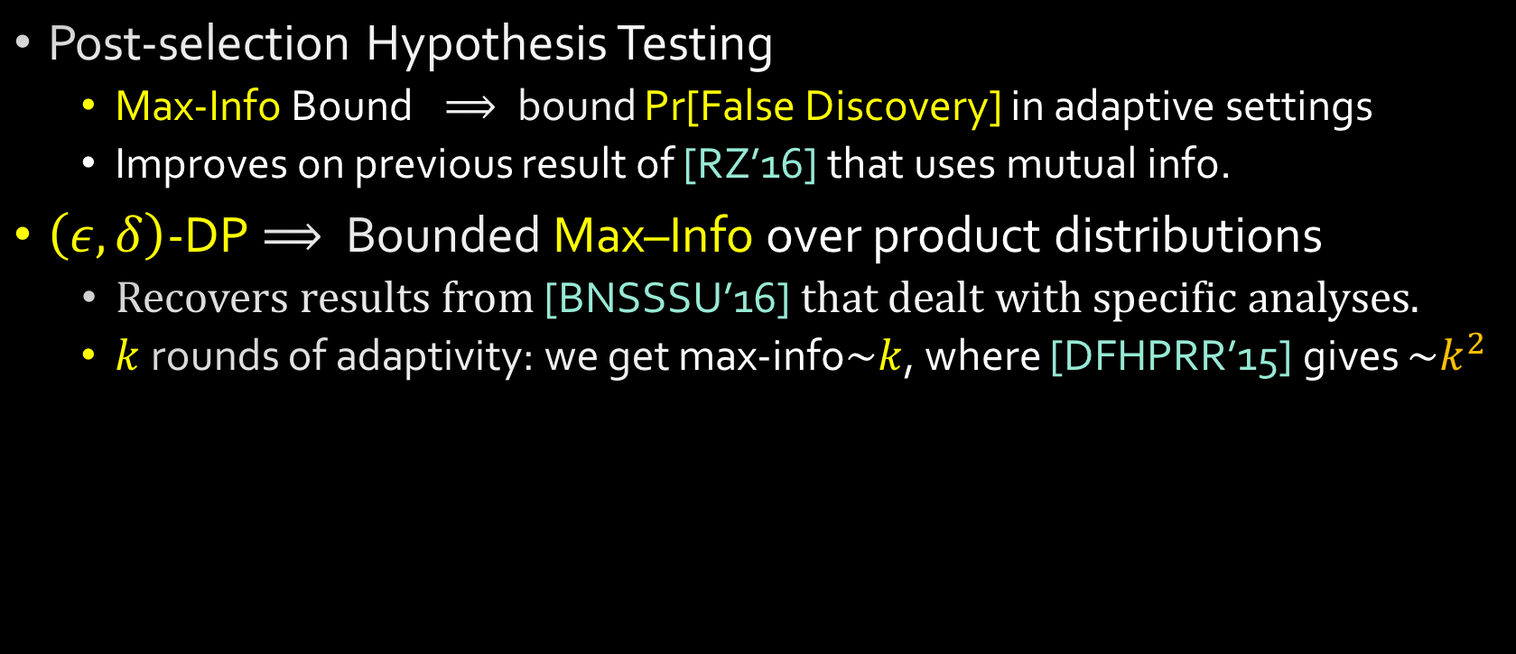
Contributions
Post-selection Hypothesis Testing
Max-Info Bound$⟹$bound Pr[False Discovery] in adaptive settings
Improves on previous result of [RZ’16] that uses mutual info.
$\left(ε,δ\right)$-DP$⟹$ Bounded Max–Info over product distributions
Recovers results from [BNSSSU’16] that dealt with specific analyses.
$k$ rounds of adaptivity: we get max-info$\sim k$, where [DFHPRR’15] gives $\sim k^{2}$
Thanks!
Notes:
Modeling Adaptive Data Analysis.

Slide 19




Data Analysis
??
$$t$$
$$t\left(X\right)$$
Analysis $t$
Notes:
Want to consider a general model for data analysis.
Poses some question or hypothesis.

Slide 20
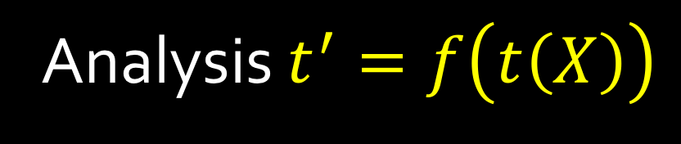
Data Analysis
Nothing Significant
??
$$t$$
$$t\left(X\right)$$
Analysis $t^{′}=f\left(t\left(X\right)\right)$
Notes:
Want to consider a general model for data analysis.
Poses some question or hypothesis.

Slide 21

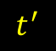
Data Analysis - Ideal
??
$$t$$
$$t\left(X\right)$$
$$t^{′}$$
$$t^{′}\left(X^{′}\right)$$
Analysis $t^{′}=f\left(t\left(X\right)\right)$
A lot of existing theory assumes tests are
selected independently of the data.
Notes:
Want to consider a general model for data analysis.
Poses some question or hypothesis.

Slide 22
Ideal World
Real World
How can we provide statistically valid answers to adaptively chosen analyses?
Notes:
More realistic because data collection is expensive.
Modeling the real world in this way captures many settings:
…
One analyst, adaptive sequence of analysis
Feature selection → Regression
Many analysts, different research groups
1 paper inspires subsequent work

Slide 23

Ideal World
Real World
How can we provide statistically valid answers to adaptively chosen analyses?
Notes:
More realistic because data collection is expensive.
Modeling the real world in this way captures many settings:
…
One analyst, adaptive sequence of analysis
Feature selection → Regression
Many analysts, different research groups
1 paper inspires subsequent work

Slide 24




??
$$t$$
$$t\left(X\right)$$
$$t^{′}$$
$$t^{′}\left(X^{′}\right)$$
$$t^{′}=f\left(t\left(X\right)\right)$$
A lot of existing theory assumes tests are
selected independently of the data.
Notes:
Want to consider a general model for data analysis.
Poses some question or hypothesis.

Slide 25

??
$$t$$
$$t\left(X\right)$$
$$t^{′}$$
$$t^{′}\left(X\right)$$
$$t^{′}=f\left(t\left(X\right)\right)$$
A lot of existing theory assumes tests are
selected independently of the data.
Notes:
Want to consider a general model for data analysis.
Poses some question or hypothesis.

Slide 26
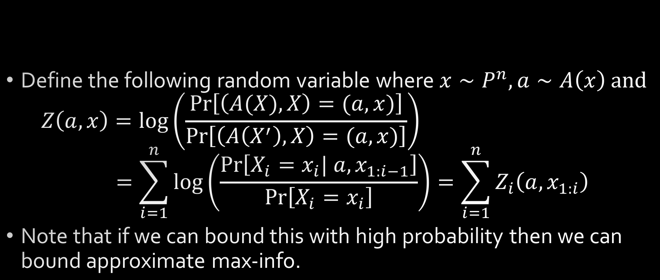

Proof Sketch of Positive Result
Theorem: If $A:D^{n}→T$ is ($ε,δ)$-DP, then
$I_{∞,Π}^{β}\left(A;n\right)≤\tilde{O}\left(ε^{2}n \right)$ where $β≈n\sqrt{\frac{δ}{ε}}$
Define the following random variable where $x∼P^{n}, a∼A\left(x\right)$ and
$$Z\left(a,x\right)=\log\left(\frac{\operatorname{Pr}\left[\left(A(X),X\right)=(a,x)\right]}{\operatorname{Pr}\left[\left(A\left(X^{′}\right),X\right)=(a,x)\right]}\right)$$
$$=\sum_{i=1}^{n}{\log\left(\frac{\operatorname{Pr}\left[X_{i}=x_{i}| a, x_{1:i−1}\right]}{\operatorname{Pr}\left[X_{i}=x_{i}\right]}\right)=\sum_{i=1}^{n}{Z_{i}\left(a,x_{1:i}\right) } }$$
Note that if we can bound this with high probability then we can bound approximate max-info.
Notes:
Differential privacy Conditioning on the output affects the input.

Slide 27
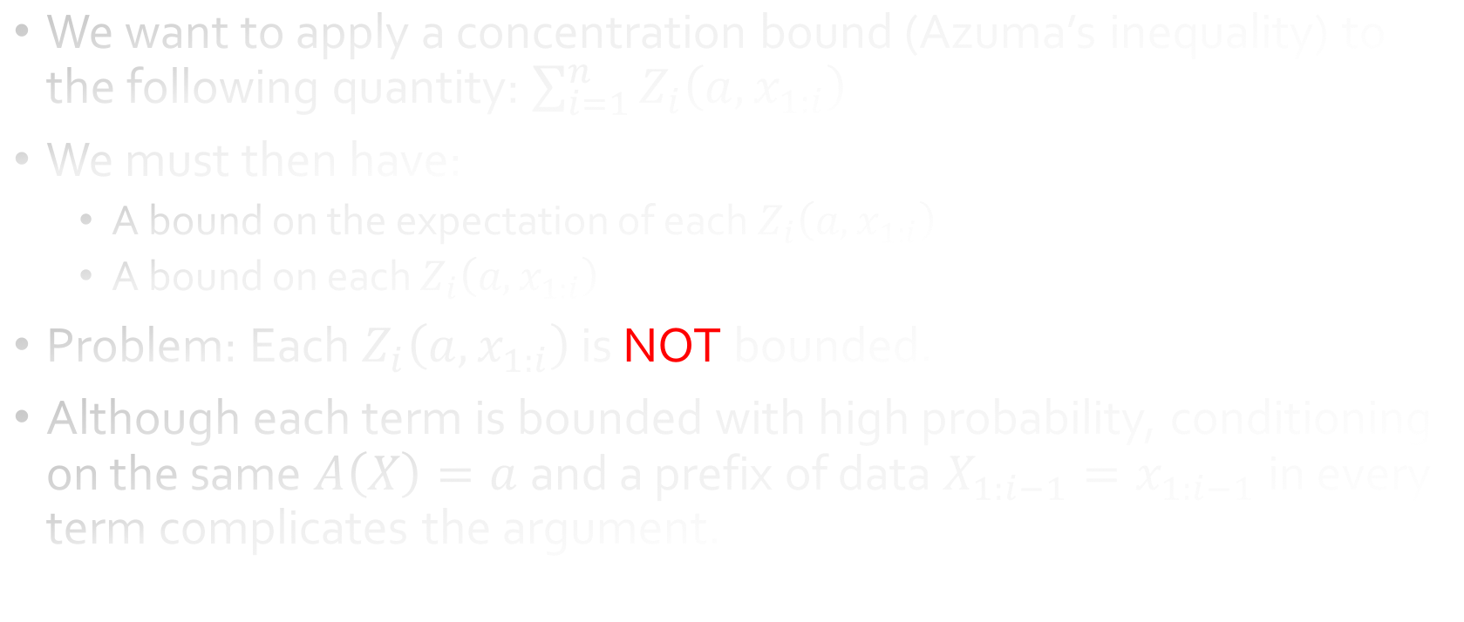
Proof Sketch of Positive Result
We want to apply a concentration bound (Azuma’s inequality) to the following quantity: $\sum_{i=1}^{n}{Z_{i}\left(a,x_{1:i}\right) }$
We must then have:
A bound on the expectation of each $Z_{i}\left(a,x_{1:i}\right)$
A bound on each $Z_{i}\left(a,x_{1:i}\right)$
Problem: Each $Z_{i}\left(a,x_{1:i}\right)$ is NOT bounded.
Although each term is bounded with high probability, conditioning on the same $A\left(X\right)=a$and a prefix of data $X_{1:i−1}=x_{1:i−1}$in every term complicates the argument.

Slide 28
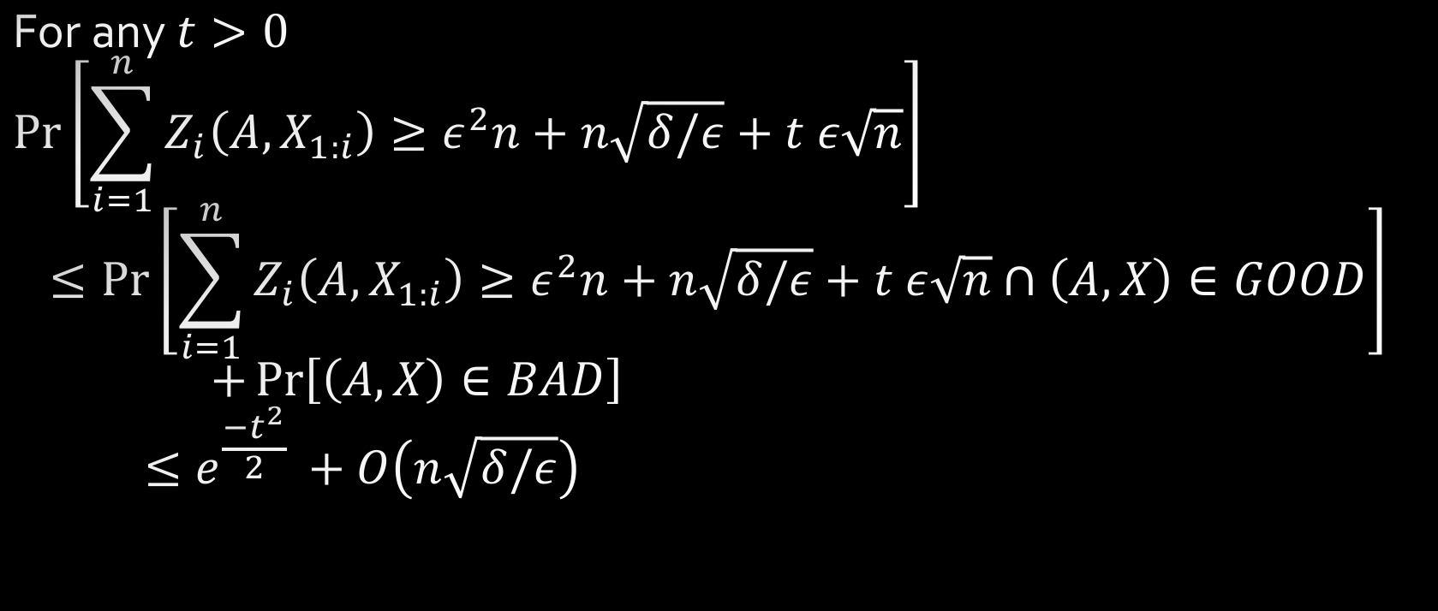
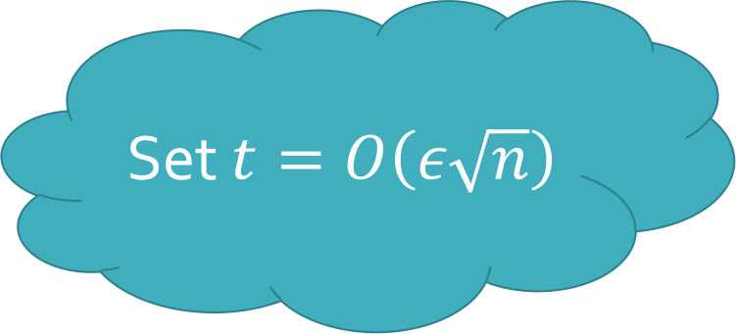
Proof Sketch of Positive Result
For any $t>0$
$$\operatorname{Pr}\left[\sum_{i=1}^{n}{Z_{i}\left(A,X_{1:i}\right)≥ε^{2}n+n\sqrt{δ/ε}+t ε\sqrt{n}}\right]$$
$$≤\operatorname{Pr}\left[\sum_{i=1}^{n}{Z_{i}\left(A,X_{1:i}\right)≥ε^{2}n+n\sqrt{δ/ε}+t ε\sqrt{n}∩\left(A,X\right)∈GOOD}\right]$$
$$+\operatorname{Pr}\left[\left(A,X\right)∈BAD\right]$$
$$≤e^{\frac{{−t}^{2}}{2} }+O\left(n\sqrt{δ/ε}\right)$$
Set $t=O\left(ε\sqrt{n}\right)$
Notes:
Mean is not just bounded by \eps^2 because we cannot just add a KL term which is guaranteed to be nonnegative. We only sum across part of the domain (because it is unbounded in some places) and so we can obtain a bound on how negative this almost KL divergence term can be.

Slide 29

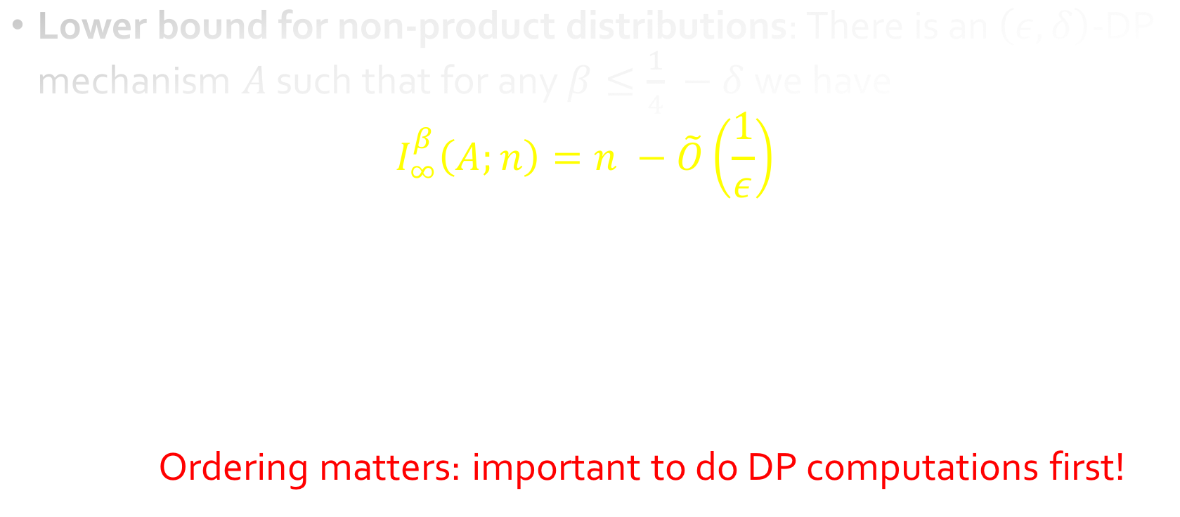

Technical Contributions
Lower bound for non-product distributions: There is an $\left(ε,δ\right)$-DP mechanism $A$ such that for any $β≤\frac{1}{4} −δ$ we have
$$I_{∞}^{β}\left(A;n\right)=n −\tilde{O}\left(\frac{1}{ε}\right)$$
Ordering matters: important to do DP computations first!
$$X\sim P^{n}$$
Notes:
Negative Result.
In fact, we show this result by starting with a dataset drawn from a product distribution and applying a bounded description length algorithm followed by an approximate DP algorithm which uses the output of the first. The result can then output the entire dataset with high probability.
Thus, we cannot obtain statistically valid answers after this ordering of test selection procedures.
Ordering matters!

Slide 30
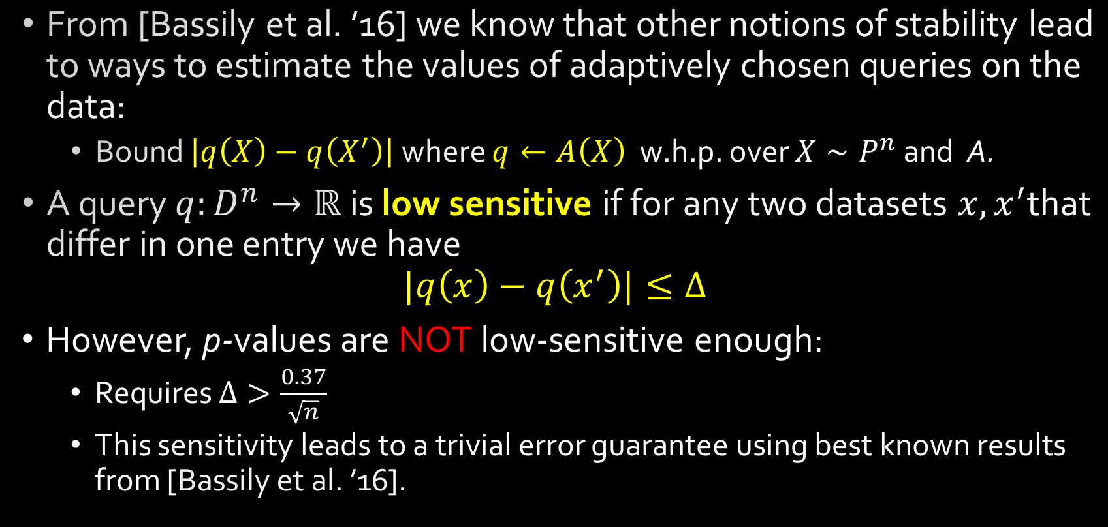
Stability with Low-Sensitivity Queries
From [Bassily et al. ’16] we know that other notions of stability lead to ways to estimate the values of adaptively chosen queries on the data:
Bound $\left|q\left(X\right)−q\left(X^{′}\right)\right|$ where $q←A\left(X\right)$ w.h.p. over $X∼P^{n}$ and A.
A query $q:D^{n}→ℝ$ is low sensitive if for any two datasets $x, x^{′}$that differ in one entry we have
$$|q\left(x\right)−q\left(x^{′}\right)|≤Δ$$
However, p-values are NOT low-sensitive enough:
Requires $Δ>\frac{0.37}{\sqrt{n}}$
This sensitivity leads to a trivial error guarantee using best known results from [Bassily et al. ’16].

Slide 31






$$A$$
$$A(X)$$
$$t$$
$$t(X)$$
$$t←A\left(X\right)$$
$$X\sim P^{n}$$
Notes:
We then model the analyst as adaptively selecting different tests.

Slide 32
Consequences of Results
Max-Info also satisfies strong composition guarantees.
Pure DP and bounded description length algorithms can be composed in arbitrary order and still have good generalization.
Not the case for approx DP, because data must be from a product distribution.
Ordering matters: important to do DP computations first!

